Slide 1
Limit cycle oscillations in Goland wing with actuator free play
Francisco Javier Martín López
Alejandro Rivera Míguez
Alberto Rivero García

Slide 2
Introduction

Slide 3
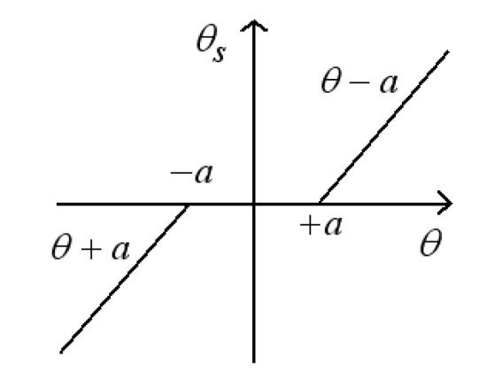




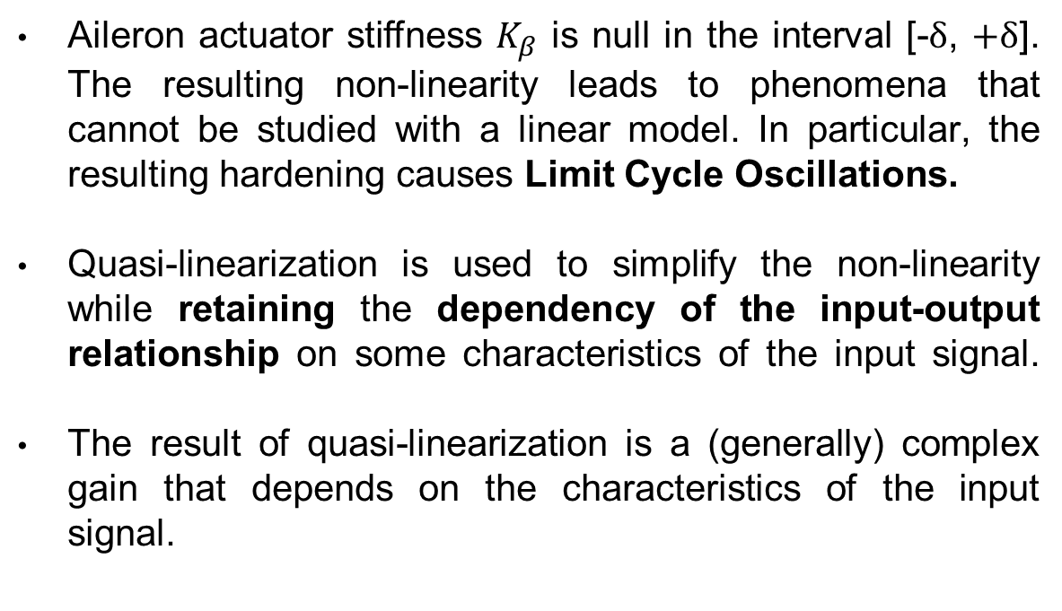
1.1 Introduction Free Play
Aileron actuator stiffness $K_{β}$ is null in the interval [-$δ$, $+δ$]. The resulting non-linearity leads to phenomena that cannot be studied with a linear model. In particular, the resulting hardening causes Limit Cycle Oscillations.
Quasi-linearization is used to simplify the non-linearity while retaining the dependency of the input-output relationship on some characteristics of the input signal.
The result of quasi-linearization is a (generally) complex gain that depends on the characteristics of the input signal.
F
$$δ$$
$$δ$$
$$δ$$
$$δ$$

Slide 4
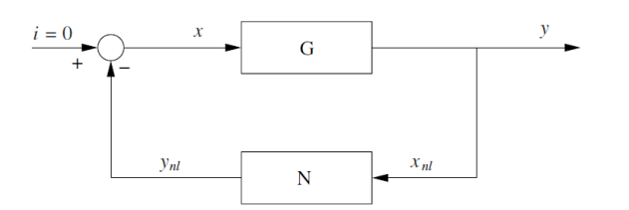
1.2 Introduction Describing function
Historically [1], it has been observed that the presence of free-play in the aileron results in LCO of the wing at certain speeds. A LCO is a constant amplitude oscillation in a system with dissipative forces.
Quasi-linearization of the free-play was done using the sinusoidal input describing function (SIDF). This describing function is well suited to analyze LCOs in systems with odd non-linearities [2].
The combination of the DF and the system dynamics could be seen as this feedback system:

Slide 5
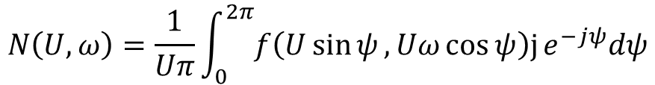
1.2 Introduction Describing function - 2
The SIDF neglects all higher harmonics. Therefore, the approximation will only be good if the system filters out these harmonics.
The SIDF is computed with the following formula [2]:
$$N\left(U,ω\right)=\frac{1}{Uπ}\int_{0}^{2π}{f\left(U\sin{ψ},Uω\cos{ψ}\right)\text{j}}e^{−jψ}dψ$$

Slide 6

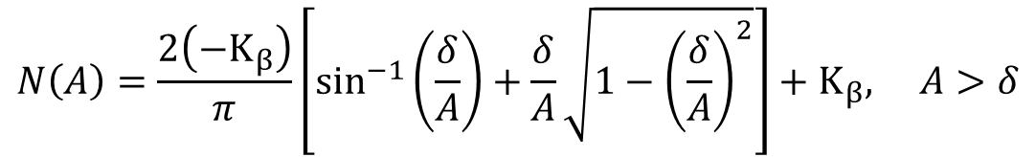

1.3 Introduction Describing function - 3
For the free-play problem, the analytical form of the describing function $N\left(A\right)$ is given by:
Since the free-play non-linearity is odd and single-valued the DF has no quadrature component. As a consequence, it will not affect the phase of the signal.
$$N\left(A\right)=0, A≤δ$$
$$N\left(A\right)=\frac{2\left(−K_{β}\right)}{π}\left[\sin^{−1}\left(\frac{δ}{A}\right)+\frac{δ}{A}\sqrt{1−{\left(\frac{δ}{A}\right)}^{2}}\right]+K_{β}, A>δ$$

Slide 7
Resolution Methodology

Slide 8
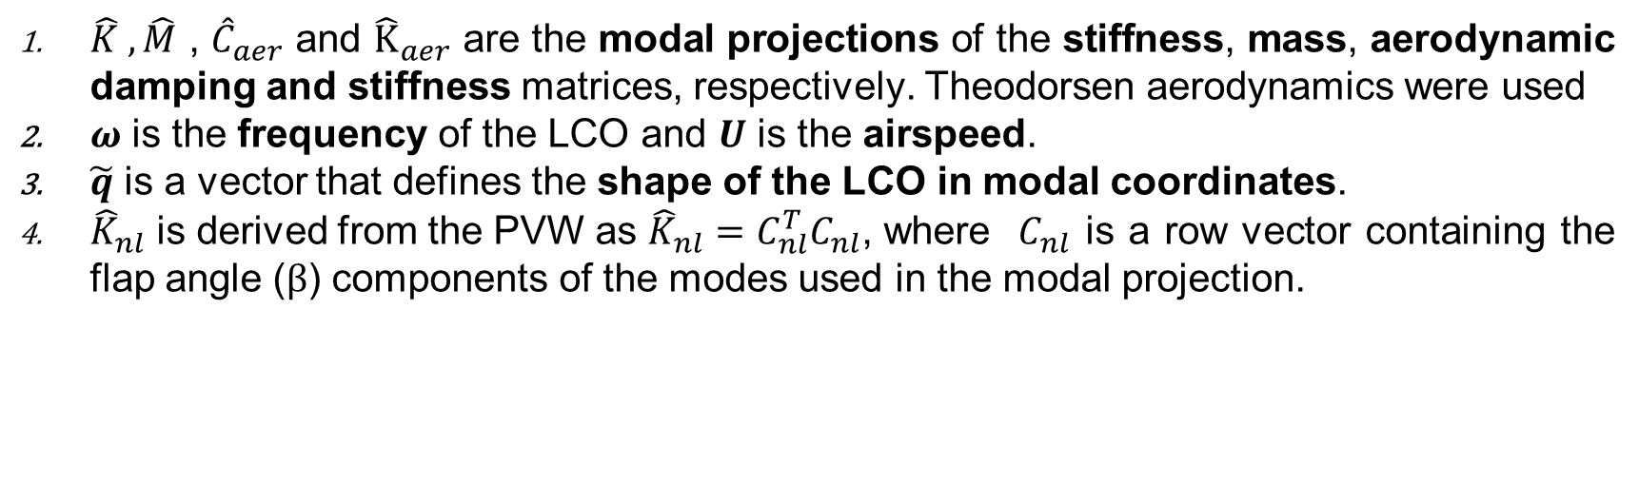
2.1. Resolution Methodology Goland Wing base problem modifications
The LCO in this system will be characterized by the vibration of all the components of the state with a constant amplitude. The nature of this oscillation will be defined by the dynamics of the feedback system. In the frequency domain:
$$(−ω^{2}\hat{M}−jωU{\hat{C}}_{theo}+\hat{K}+{\hat{K}}_{nl}N(A)−U^{2}{\hat{K}}_{theo})\tilde{q}=0$$
Where:
$\hat{K} , \hat{M}$ , ${\hat{C}}_{aer}$ and ${\hat{K}}_{aer}$ are the modal projections of the stiffness, mass, aerodynamic damping and stiffness matrices, respectively. Theodorsen aerodynamics were used
$ω$ is the frequency of the LCO and $U$ is the airspeed.
$\tilde{q}$ is a vector that defines the shape of the LCO in modal coordinates.
${\hat{K}}_{nl}$ is derived from the PVW as ${\hat{K}}_{nl}=C_{nl}^{T}C_{nl}$, where $C_{nl}$ is a row vector containing the flap angle ($β$) components of the modes used in the modal projection.

Slide 9
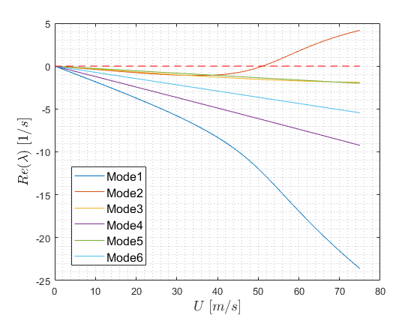
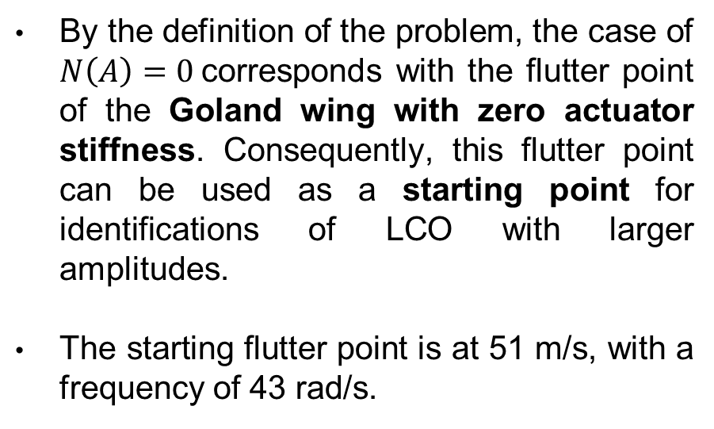
2.1. Resolution Methodology Goland Wing base problem modifications
By the definition of the problem, the case of $N\left(A\right)=0$corresponds with the flutter point of the Goland wing with zero actuator stiffness. Consequently, this flutter point can be used as a starting point for identifications of LCO with larger amplitudes.
The starting flutter point is at 51 m/s, with a frequency of 43 rad/s.

Slide 10
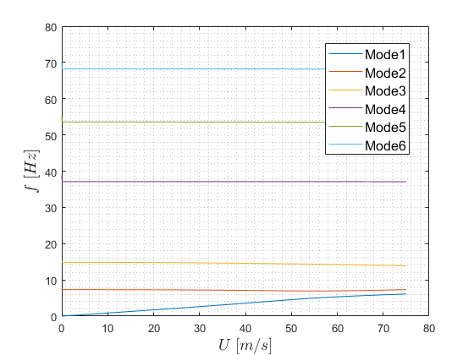
2.1. Resolution Methodology Goland Wing base problem modifications
By observing the damping and frequency plots of this model it can be concluded that the flutter mechanism involves the first 2 modes.
With this in mind, the model for LCO identification is initially based on these 2 modes.

Slide 11





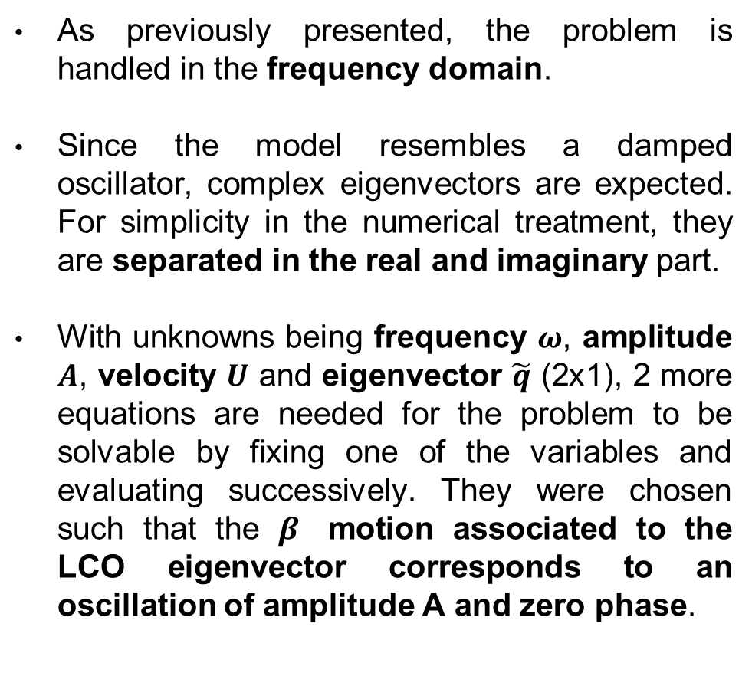
2.1. Resolution Methodology Goland Wing equations development
As previously presented, the problem is handled in the frequency domain.
Since the model resembles a damped oscillator, complex eigenvectors are expected. For simplicity in the numerical treatment, they are separated in the real and imaginary part.
With unknowns being frequency $ω$, amplitude $A$, velocity $U$ and eigenvector $\tilde{q}$ (2x1), 2 more equations are needed for the problem to be solvable by fixing one of the variables and evaluating successively. They were chosen such that the $β$ motion associated to the LCO eigenvector corresponds to an oscillation of amplitude A and zero phase.
$$\hat{M}\hat{\ddot{q}}+\hat{C}\hat{\dot{q}}+\hat{K}\hat{q}+{\hat{K}}_{nl}\hat{q}=0$$
$$−ω^{2}\hat{M}\tilde{q}+jω\hat{C}\tilde{q}+\hat{K}\tilde{q}+{\hat{K}}_{nl}\tilde{q}=0$$
$$\left(−ω^{2}\hat{M}+\hat{K}+{\hat{K}}_{nl}\right)Re\left(\tilde{q}\right)−ω\hat{C}Im\left(\tilde{q}\right)=0$$
$$\left(−ω^{2}\hat{M}+\hat{K}+{\hat{K}}_{nl}\right)Im\left(\tilde{q}\right)+ ω\hat{C}Re\left(\tilde{q}\right)=0$$
$$C_{nl}q_{r} = A$$
$$C_{nl}q_{i} = 0$$

Slide 12



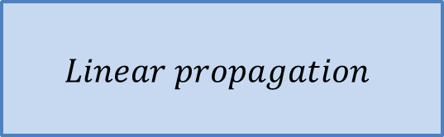
2.2. Resolution Methodology LCO Computation
The characteristics of the LCO as a function of A have been computed with a continuation algorithm. Starting from the flutter point, an initial guess is obtained by linear propagation. This guess is refined with a Newton-Raphson method up to a specified tolerance. The process is repeated over the desired range of amplitude.
$$A_{i+1}=A_{i}+ΔA$$
$$Linear propagation$$
$$Newton−Raphson$$
Initial guess
LCO solution for $A_{i}$

Slide 13
Results

Slide 14
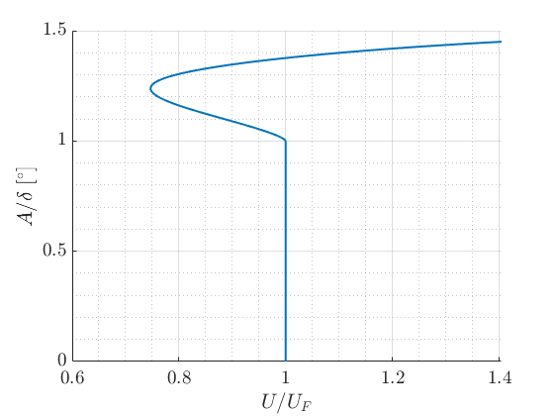
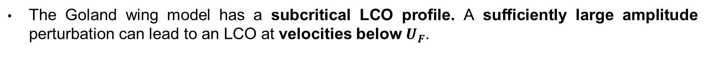
3.1. Results LCO Curve
The Goland wing model has a subcritical LCO profile. A sufficiently large amplitude perturbation can lead to an LCO at velocities below $U_{F}$.

Slide 15
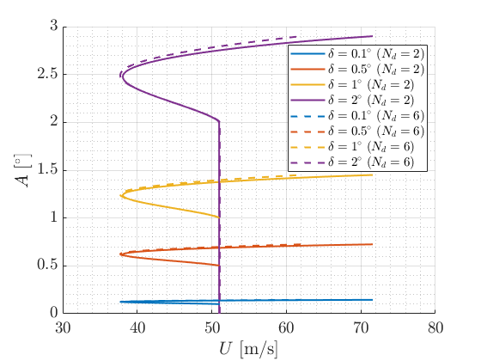
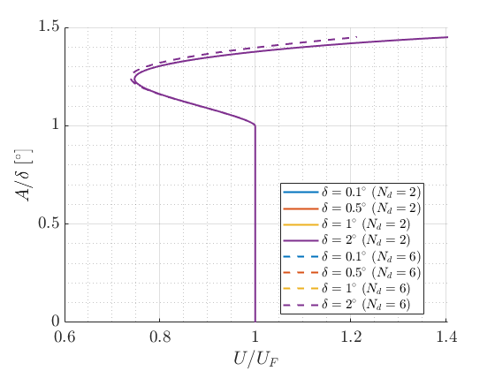
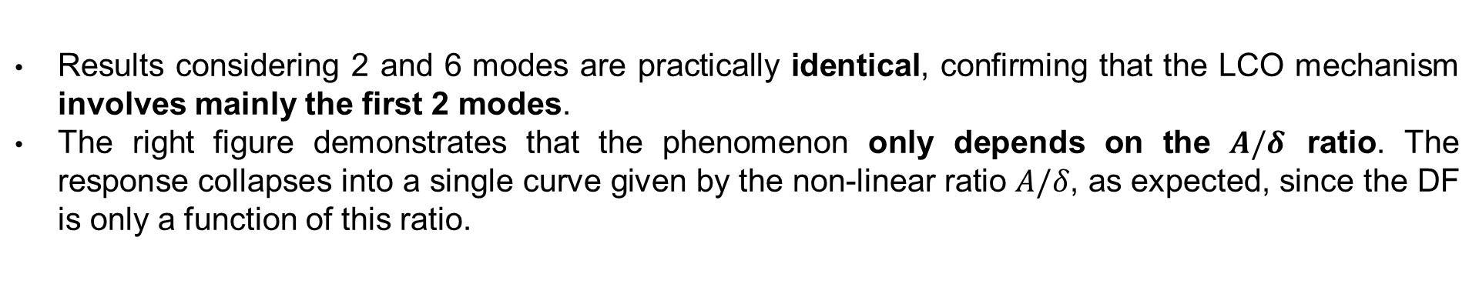
3.1. Results LCO Curve - Amplitude
Results considering 2 and 6 modes are practically identical, confirming that the LCO mechanism involves mainly the first 2 modes.
The right figure demonstrates that the phenomenon only depends on the $A/δ$ ratio. The response collapses into a single curve given by the non-linear ratio $A/δ$, as expected, since the DF is only a function of this ratio.

Slide 16
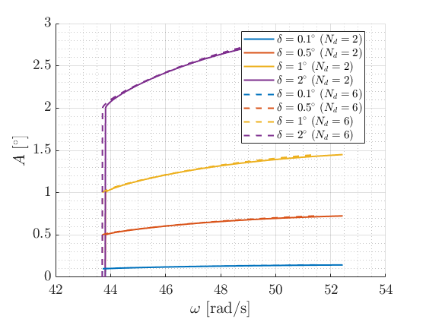
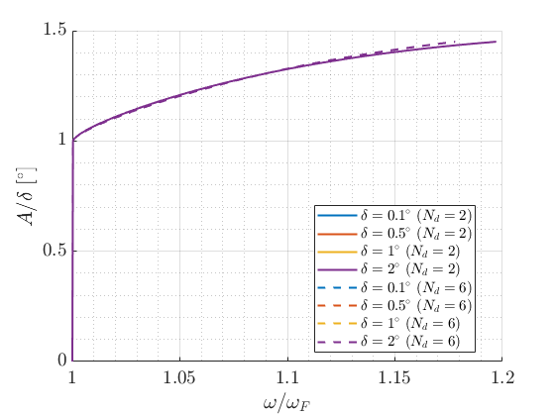
3.1. Results LCO Curve - Frequency
The LCO frequency increases by approx. 10% as amplitude grows. This confirms the hardening stiffness behavior of the wing.
Comments made for amplitude apply also to frequency plots.

Slide 17
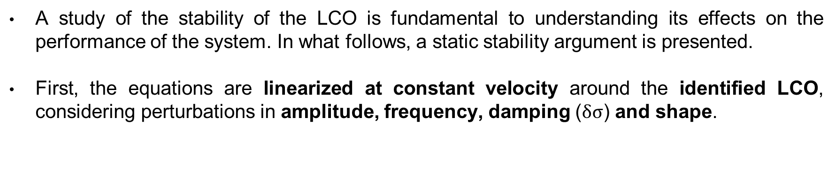
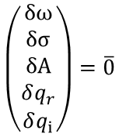
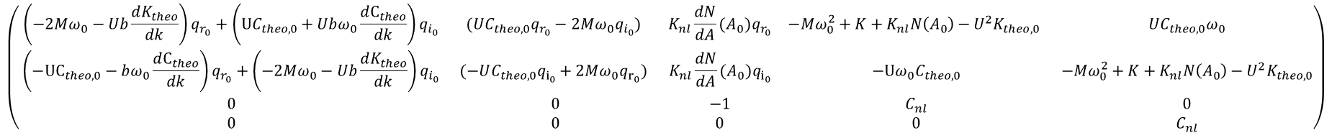
3.2. Results LCO Stability analysis - Methodology
A study of the stability of the LCO is fundamental to understanding its effects on the performance of the system. In what follows, a static stability argument is presented.
First, the equations are linearized at constant velocity around the identified LCO, considering perturbations in amplitude, frequency, damping ($δσ$) and shape.
$$\left(\begin{matrix} \left(−2Mω_{0}−Ub\frac{dK_{theo}}{dk}\right)q_{r_{0}}+\left(\text{U}C_{theo,0}+Ubω_{0}\frac{dC_{theo}}{dk}\right)q_{i_{0}} & (UC_{theo,0}q_{r_{0}}−2Mω_{0}q_{i_{0}}) & K_{nl}\frac{dN}{dA}(A_{0})q_{r_{0}} & −Mω_{0}^{2}+K+K_{nl}N\left(A_{0}\right)−U^{2}K_{theo, 0} & UC_{theo,0}ω_{0} \\ \left(−\text{U}C_{theo,0}−bω_{0}\frac{dC_{theo}}{dk}\right)q_{r_{0}}+\left(−2Mω_{0}−Ub\frac{dK_{theo}}{dk}\right)q_{i_{0}} & (−UC_{theo,0}q_{i_{0}}+2Mω_{0}q_{r_{0}}) & K_{nl}\frac{dN}{dA}(A_{0})q_{i_{0}} & −Uω_{0}C_{theo,0} & −Mω_{0}^{2}+K+K_{nl}N\left(A_{0}\right)−U^{2}K_{theo, 0} \\ 0 & 0 & −1 & C_{nl} & 0 \\ 0 & 0 & 0 & 0 & C_{nl}\end{matrix}\right)$$
$$\left(\begin{matrix}δω \\ δσ \\ δA \\ δq_{r} \\ δq_{i}\end{matrix}\right)=\overline{0}$$
*Where the 0 subindex means the identified LCO at airspeed U.

Slide 18
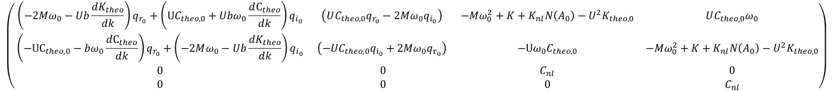

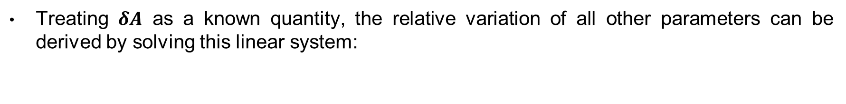
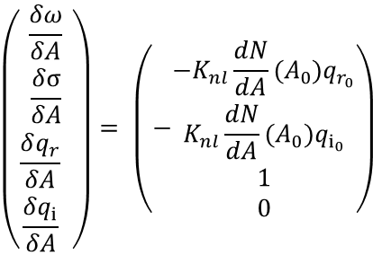
3.2. Results LCO Stability analysis – Methodology 2
Treating $δA$ as a known quantity, the relative variation of all other parameters can be derived by solving this linear system:
$$\left(\begin{matrix}\frac{δω}{δA} \\ \frac{δσ}{δA} \\ \frac{δq_{r}}{δA} \\ \frac{δq_{i}}{δA} \end{matrix}\right)= \left(−\begin{matrix}{−K}_{nl}\frac{dN}{dA}(A_{0})q_{r_{0}} \\ K_{nl}\frac{dN}{dA}(A_{0})q_{i_{0}} \\ 1 \\ 0\end{matrix}\right)$$
$$\left(\begin{matrix} \left(−2Mω_{0}−Ub\frac{dK_{theo}}{dk}\right)q_{r_{0}}+\left(\text{U}C_{theo,0}+Ubω_{0}\frac{dC_{theo}}{dk}\right)q_{i_{0}} & \left(UC_{theo,0}q_{r_{0}}−2Mω_{0}q_{i_{0}}\right) & −Mω_{0}^{2}+K+K_{nl}N\left(A_{0}\right)−U^{2}K_{theo, 0} & UC_{theo,0}ω_{0} \\ \left(−\text{U}C_{theo,0}−bω_{0}\frac{dC_{theo}}{dk}\right)q_{r_{0}}+\left(−2Mω_{0}−Ub\frac{dK_{theo}}{dk}\right)q_{i_{0}} & \left(−UC_{theo,0}q_{i_{0}}+2Mω_{0}q_{r_{0}}\right) & −Uω_{0}C_{theo,0} & −Mω_{0}^{2}+K+K_{nl}N\left(A_{0}\right)−U^{2}K_{theo, 0} \\ 0 & 0 & C_{nl} & 0 \\ 0 & 0 & 0 & C_{nl}\end{matrix}\right)$$
For the system to be statically stable the variation in damping ratio must oppose the variation in amplitude. In other words:
$$\frac{δσ}{δA}<0$$

Slide 19
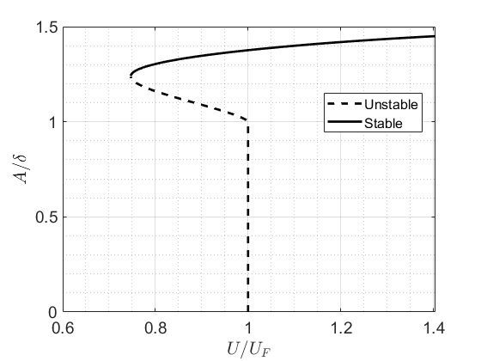
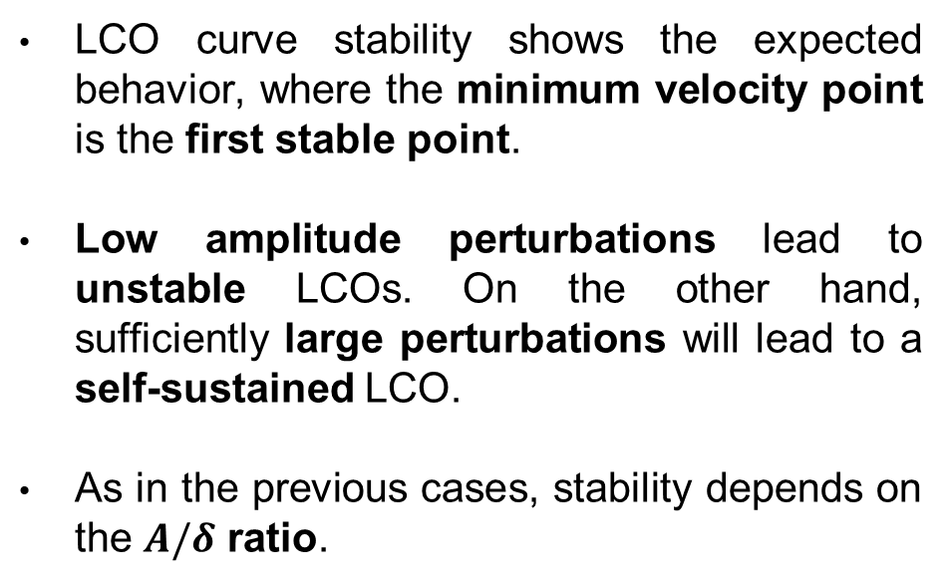
3.2. Results LCO Stability analysis - Results
LCO curve stability shows the expected behavior, where the minimum velocity point is the first stable point.
Low amplitude perturbations lead to unstable LCOs. On the other hand, sufficiently large perturbations will lead to a self-sustained LCO.
As in the previous cases, stability depends on the $A/δ$ ratio.

Slide 20
3.2. Results LCO Visualization
This animation shows the shape of the LCO, at the lowest speed at which it is stable, according to previous results.
1 deg free play in the actuator.

Slide 21
3.2. Results LCO Visualization - Scaled
Scaling the previous animation by a factor of 10 aids visualization.

Slide 22
Conclusions

Slide 23
4.1. Conclusions
The behavior of the Goland Wing with free-play in the actuator identified with the DF is subcritical.
A dynamic stability analysis would be required to gain a deeper understanding of the stability and attractiveness of the LCOs, as well as the transient behavior of the system.
Results show actuator free-play should be considered in the design phase of a wing. In this case, aeroelastic phenomena are relevant starting at 40 m/s, while the flutter velocity of the nominal system without free-play is at 117 m/s.
Using the computed shape of the LCO, it is possible to compute its effects on aircraft performance, lift generation and fatigue life of the structure.

Slide 24
Sources
[1] Conner, Mark D., et al. "Nonlinear behavior of a typical airfoil section with control surface freeplay: a numerical and experimental study." Journal of Fluids and structures 11.1 (1997): 89- 109
[2] A. Gelb and W. E. Vander Velde, "Multiple-Input Describing Functions and Nonlinear System Design." New York, NY, USA: McGraw-Hill, 1968.

Slide 25
Q&A

